Slide 1
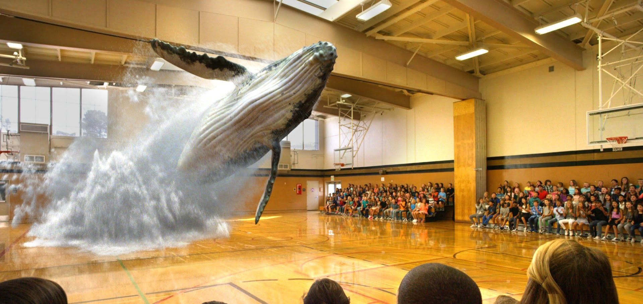
MIXED REALITY

Slide 2

ROADMAP
WHAT IS MIXED REALITY ?
HISTORY OF MR AND REALITY - VIRTUALITY CONTINUUM
Virtual Reality vs Augmented Reality vs Mixed Reality
HOW CAN MIXED REALITY MAKE LIFE EASY ?
UNDERSTANDING THE STRUCTURE OF A MIXED REALITY HMD.
DEVICES IN DEMAND FOR MR
APPLICATIONS OF MR
REFERENCES

Slide 3
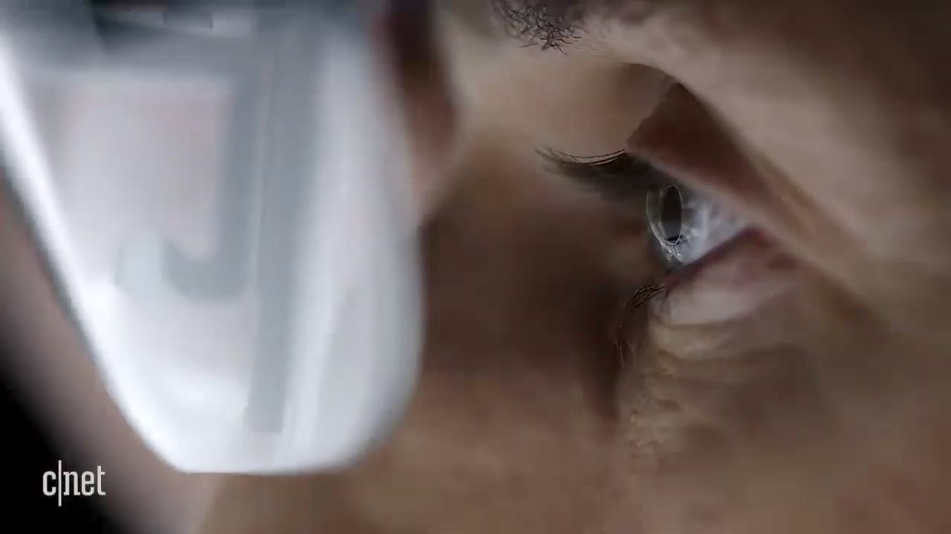
WHAT IS MIXED REALITY?
It is the merging of Real and Virtual worlds to produce new environments and visualizations where physical and digital objects co-exist and interact in real time.
Mixed reality takes place not only in the physical world or the virtual world, but is a mix of reality and virtual reality, encompassing both augmented reality and augmented virtuality via immersive technology.

Slide 4

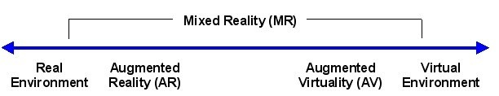
HISTORY OF MR
The first immersive mixed reality system, providing enveloping sight, sound, and touch was the Virtual Fixtures platform developed at the U.S. Air Force's Armstrong Laboratories in the early 1990s. IT LATER ON BECAME A SENSATION, HOWEVER FAILED TO REACH EXPEXTATIONS AT THAT POINT OF TIME AND NOW SINCE 2009 IT ROSE TO PROMINENECE AGAIN AND THERE IS A LOT OF MARKET FOR MR THESE DAYS.
REALITY – VIRTUALITY CONTINUUM
In 1994, Paul Milgram and Fumio Kishino defined a mixed reality as "...anywhere between the extrema of the virtuality continuum" (VC) where the virtuality continuum extends from the completely real through to the completely virtual environment with augmented reality and augmented virtuality ranging between THE SCALE. the real environment and the virtual environment are opposite sides of the same scale, and all the possible variations are encompassed inside this spectrum, thus called Mixed Reality.

Slide 5
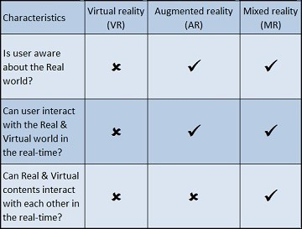
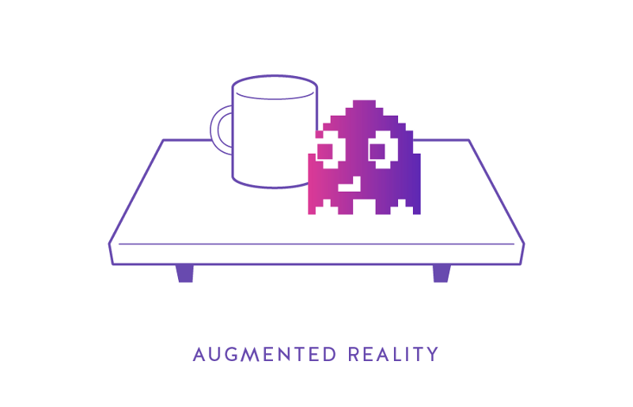
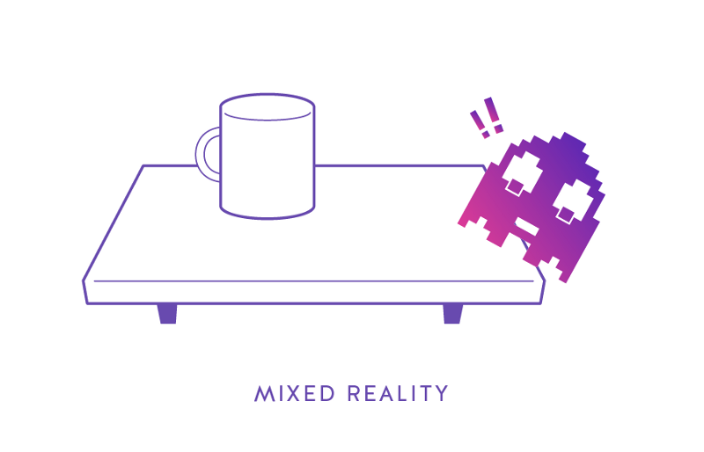
VIRTUAL REALITY vs AUGMENTED REALITY vs MIXED REALITY
In the case of VR, you are completely isolated from the real world. So, you can’t interact with the real world.
In the case of AR, the interaction between virtual contents and the real world is not possible.
in the case of MR, content from the virtual and the real world can interact with each other in the real-time. In more specific words, in the case of Mixed reality (MR), the virtual object is responsive in nature and an integral part of your real world.

Slide 6
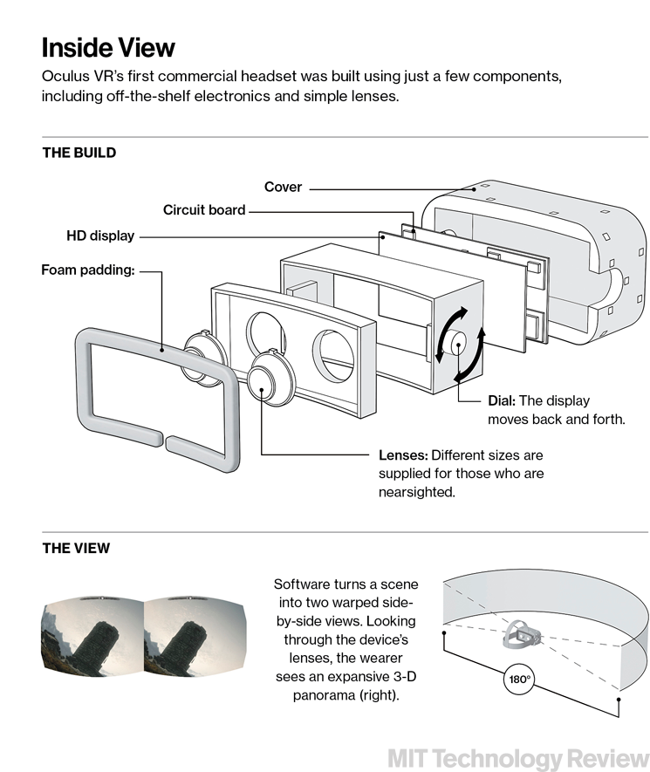
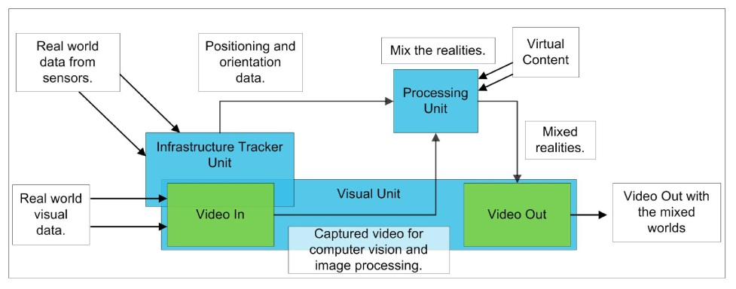
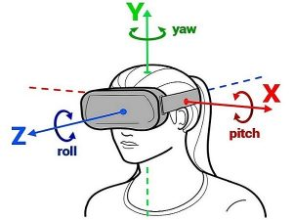
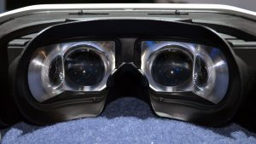
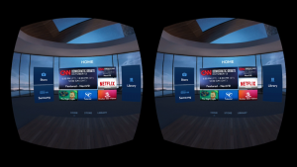
UNDERSTANDING THE STRUCTURE OF A MIXED REALITY HMD
KEY COMPONENTS:
SENSORS
LENSES
DISPLAY SCREEN
PROCESSOR

Slide 7
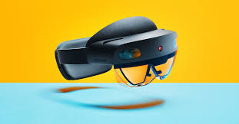
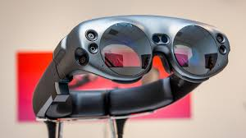
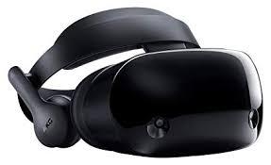
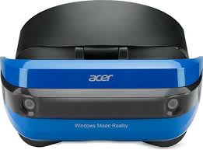
MR DEVICES IN DEMAND AND TECH GIANTS IN MR
WINDOWS HOLO LENS 2 MAGIC LEAP ONE
SAMSUNG ODYSSEY ACER AH101

